Slide 1

Title
REPORT ON INTERCITY BUS TRANSPORTATION SCHEDULE ANALYSIS
Project by Nene Perpetual Okogo

Slide 2
❓ Problem Statement:
A nationwide bus company operates multiple routes connecting major cities in Nigeria, including Abuja, Lagos, Kano, Enugu, and Port Harcourt. Each day, different operators manage scheduled trips with varying departure and arrival times. Management wants to optimize scheduling efficiency, operator performance, and route planning.
You have been given access to historical trip data for analysis. Your task is to use SQL to answer key business questions related to:
Frequency of routes and trips
Efficiency and reliability of operators
Travel demand patterns by date and city
Time-based insights for scheduling improvements
Operator route coverage and performance ranking

Slide 3
📌 Goals of the Analysis:
Understand the distribution of trips across cities and operators.
Identify the most and least active routes and bus stops.
Calculate time-related statistics, like earliest departures and busiest days.
Use SQL aggregations and window functions to evaluate performance per operator.
Detect overlapping or underused routes, helping management optimize their schedule.

Slide 4

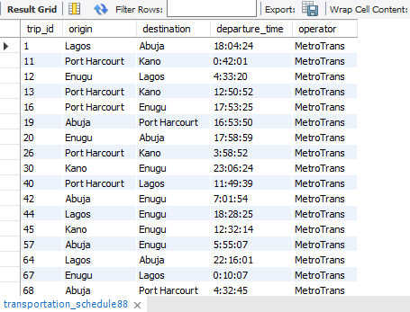
1. List all trips operated by 'MetroTrans'.

Slide 5

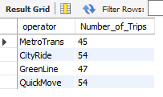
2. Find the number of trips per operator.

Slide 6
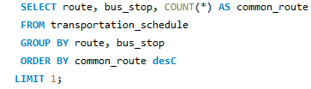

3. Identify the most common route.

Slide 7

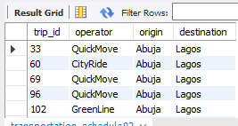
4. Get trips that originated from 'Abuja' and went to 'Lagos'.

Slide 8

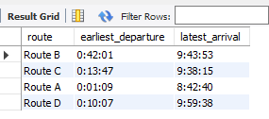
5. Find the earliest departure and latest arrival times per route.

Slide 9

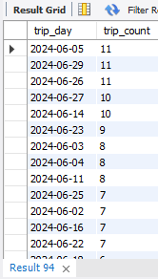
6. Count how many trips occurred on each date.

Slide 10
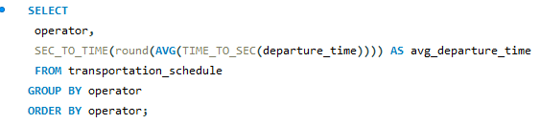
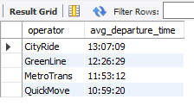
7. Group trips by operator and show average departure time.

Slide 11
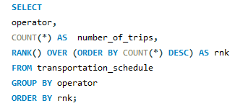
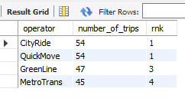
8. Use RANK() to rank operators by number of trips.

Slide 12

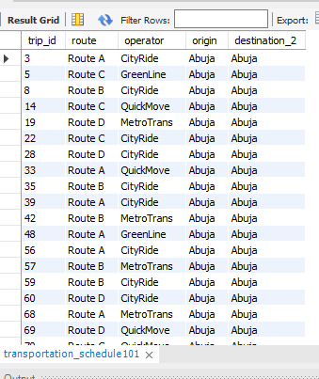
9. Identify trips where origin and destination are in the same state (you can modify schema).

Slide 13
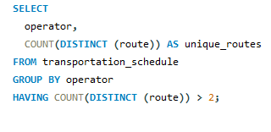
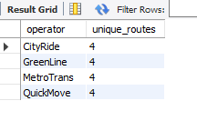
10. Find operators that serve more than 2 unique routes.

Slide 14
Recommendation
To improve efficiency and service quality, the bus company should increase trip frequency on high-demand routes like Lagos to Abuja, especially during peak hours and weekends. Operators with strong on-time performance should be prioritized for key routes, while underperforming ones should receive support or be reassigned. Scheduling can be optimized by avoiding traffic-prone hours and adjusting departure times based on travel patterns. Regular monitoring of operator performance and route demand will ensure better planning and customer satisfaction.

Slide 15

Thank You!

